Slide 1
“Smart agriculture system based on IoT”

Slide 2
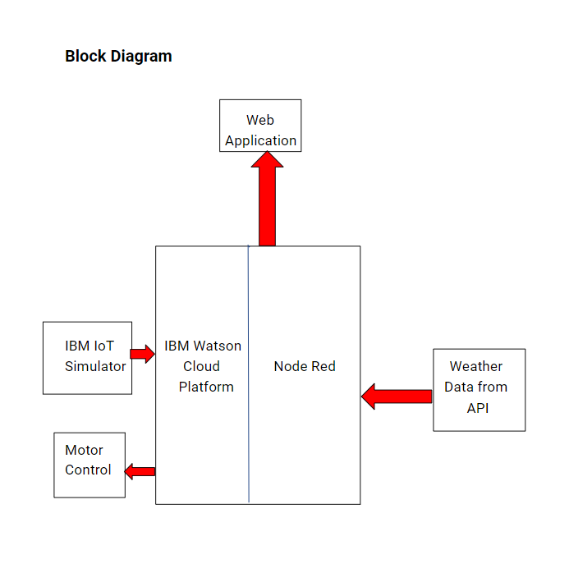

Slide 3
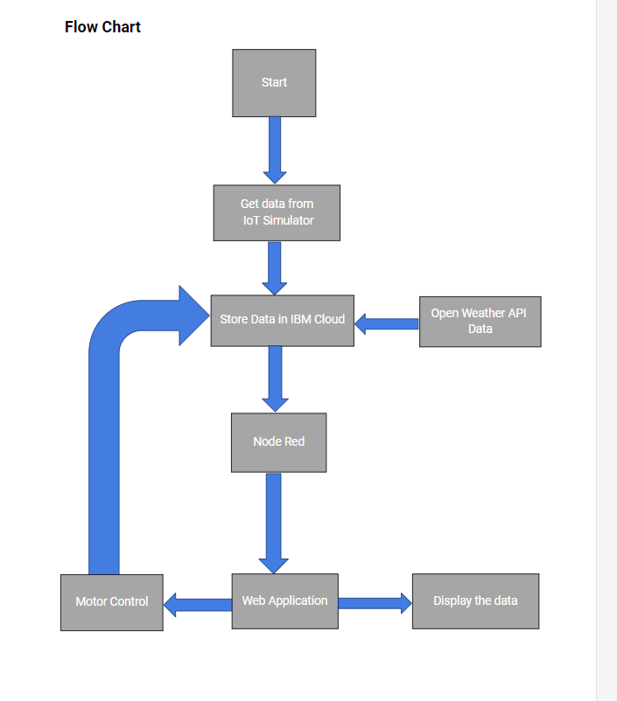

Slide 4
ADVANTAGES
It will enable the farmers to access and manage real-time data of their ﬁeld from any place.
It will increase the proﬁtability and sustainability
The eﬃciency levels will increase signiﬁcantly.
The farmers will be able to grow the crops on a large scale due to low labour and time investments.
They will be able to manually control the irrigation from any location.
They will be able to monitor the ﬁeld and weather conditions through a web app.

Slide 5
DISADVANTAGES
The farmers will rely signiﬁcantly on good technical support to fully make use of this system.
The initial cost of setting up this project could be high.

